Slide 1
Adaptive Query Suggestion for Difficult Queries
Date: 2013/1/17
Author: Yang Liu, Ruihua Song, Yu Chen, Jian-Yun Nie and Ji-Rong Wen
Source: SIGIR’12
Advisor: Jia-ling Koh
Speaker: Chen-Yu Huang

Slide 2
Outline
Introduction
Query suggestion and quality measures
Approach
Experiments on suggestion approach
Adaptive query suggestion
Conclusion

Slide 3
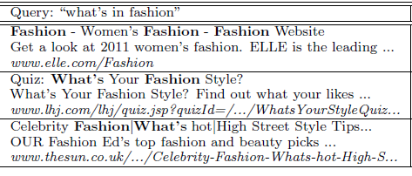
Introduction
Query expresses well the right information need, the query still fail to retrieve the desirable documents.
Ex : What’s in fashion

Slide 4
Introduction
It is critical for difficult queries, but much harder to suggest queries that perform well.
EX : “What’s in fashion”
“What’s in fashion 2010”
“What’s in fashion for men”
Goal :
To suggest more effective queries for difficult queries.

Slide 5
Outline
Introduction
Query suggestion and quality measures
Approach
Experiments on suggestion approach
Adaptive query suggestion
Conclusion

Slide 6
Query suggestion
Two-step process
Give a query q, a set of candidate queries C = {c1,c2,….cm}
Candidates are ranked according to some quality criterion.

Slide 7
Query suggestion
The best suggestion list can be seen as the one in which the suggested queries are ranked in decreasing order of their relevance probability P(rel = 1 | q, ci).
The key problem :
Find an optimal function r(q, ci) to estimate
P(rel = 1 |q, ci).
A useful suggestion should be the one that improves the search effectiveness.
Change the previous relevance probability to the usefulness probability P( useful = 1 | q, ci )

Slide 8
Outline
Introduction
Query suggestion and quality measures
Approach
Experiments on suggestion approach
Adaptive query suggestion
Conclusion

Slide 9
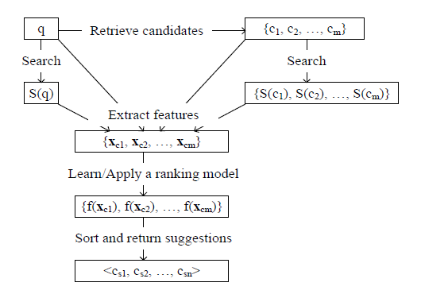
Approach
Work flow

Slide 10
Retrieve candidates
Mine the query clusters from click-through data and retrieve candidates based on query clusters.
Build a click-through bipartite graph from search logs collect on Bing.
e11(w11 = 10)
u1
qi : query
ui : URL
ei : between qi and uj, if uj has been
clicked when user issued qi
wij : click number
q1
e12(w12 = 20)
e21(w21 = 30)
u2
q2
e23(w23 = 5)
u3

Slide 11
Retrieve candidates
Use the cluster method to creates a set of clusters as it scans through the queries.
Divide queries in each query cluster into intent group
Ex: spelling correction, stop words removal, stemming
Select the most frequent query in each group to be the group leader which will be return as a candidate.

Slide 12
Extract Features
Extract some features to measure how well candidate ci performs.
The feature are extracted from ( q, S(q), ci, S(ci) ).
S(q) : search result by Bing for q
S(ci) : search result by Bing for ci

Slide 13
Extract Features
Match Feature :
to measure how well a candidate matches its own search result
Three parts : title, snippet and URL
EX : Title
Ti ,j :title of the j-th result in S(ci)
TF : term frequency

Slide 14
Extract Features
Cross Match Features :
to measure how well a candidate’s search result S(ci) matches the original query q
Three parts : title, snippet and URL
EX: Title

Slide 15
Extract Features
Similarity Features :
to measure similarity between a candidate and the original query
Three similarity feature : result page, URLs and domains
NDCG Features :
How relevant a set of search result is to the original query

Slide 16
Quality measures
Evaluate an individual suggestion
Choose NDCG to evaluate an individual suggestion.
NDCG @ k =
Rating(i) : the relevance rating of the document at position i.
5 grades of relevance.
DCG@k
Grade of relevance | Corresponding rating
Perfect | 4
Excellent | 3
Good | 2
Fair | 1
Bad | 0
IDCG@k

Slide 17
Quality measures
Evaluate a suggestion list
Use the maximum NDCG@k achievable by these n suggestion, denoted by Max@n, as a quality measure of the list.
Ex : NDCG@3 values of top five suggestions
< 0.4 , 0.6 , 0.5 , 0.7 , 0.2 >

Slide 18
Quality measures
Evaluate a suggestion list
Use the SDCG@n to measure the overall quality of a suggestion list.
Assume that the user scans the suggestion list from top to bottom.
N : the total number of suggestions in a suggestion list.
NDCG@k(i) : the quality of the suggestion at position i.

Slide 19
Learn to rank suggestion
Use a pairwise learning-to-rank method, RankSVM to rank the candidate.
Input: C = {c1, c2, ….cn}
RankSVM
Output : score = {s1, s2, ….sn}

Slide 20
Outline
Introduction
Query suggestion and quality measures
Approach
Experiments on suggestion approach
Adaptive query suggestion
Conclusion

Slide 21
Experiment on suggestion approach
Data collection
Dataset : 10000 real web queries from the search logs of Bing
Queries : 4068
Fetch the top three search result
calculate NDCG@3 for each original queries

Slide 22
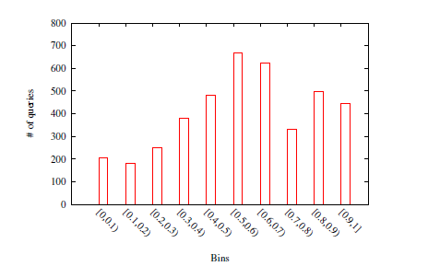
Experiment on suggestion approach
Data collection
Divide the original queries into 10 bins according to their NDCG@3 values

Slide 23
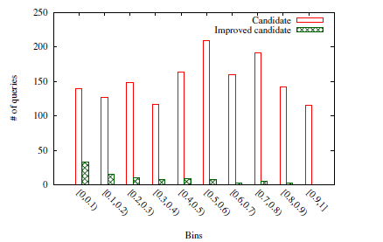
Experiment on suggestion approach
Data collection
Identifies 638391 suggestion candidates.
Improved candidate : If a candidate has a higher NDCG@3 value than its original query

Slide 24
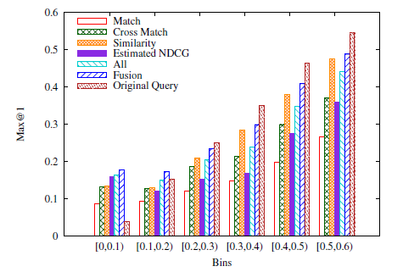
Experiment on suggestion approach
Evaluate ranking models
10-fold cross validation
NDCG values are below 0.4 in the training data

Slide 25
Experiment on suggestion approach
Compare with baseline
Collect suggestions from SE1 and SE2 as two additional baselines
Randomly choose five queries from candidates to form suggestions

Slide 26
Experiment on suggestion approach
Compare with baseline

Slide 27
Experiment on suggestion approach
Compare with baseline

Slide 28
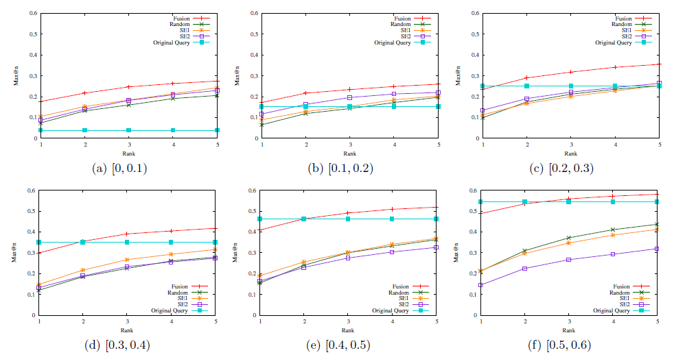
Experiment on suggestion approach
Compare with baseline

Slide 29
Outline
Introduction
Query suggestion and quality measures
Approach
Experiments on suggestion approach
Adaptive query suggestion
Conclusion

Slide 30
Adaptive query suggestion
A key problem is to predict how difficult a query is.
Choose to use RAPP method to predict.
The key idea behind the approach is to use the ranking document(e.g. BM25, click and PageRank), to predict the quality of the results.

Slide 31
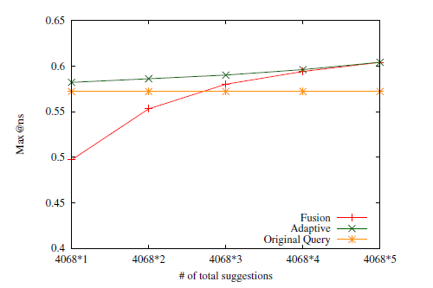
Adaptive query suggestion
Experiment
m suggestion slots per query on average
Total suggestion slots : 4068 * m

Slide 32
Conclusion
First investigation of query suggestion according to query difficulty.
An adaptive approach is proposed to provide suggestions according to the estimation on query difficulty.
Proposed two new evaluation measures.

